Slide 1
System Programming
System Software:
An Introduction to Systems Programming
Leland L. Beck
3rd Edition
Addison-Wesley, 1997

Slide 2
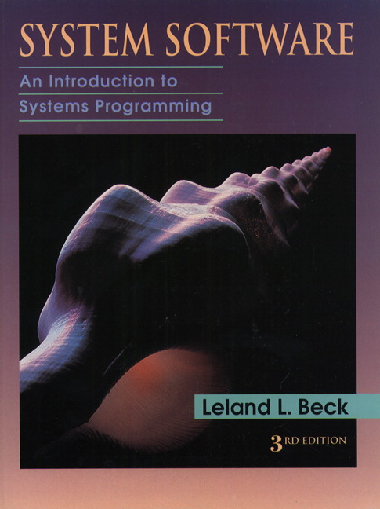
Book

Slide 3
System Programming
Chapter 1: Background
Chapter 2: Assemblers
Chapter 3: Loaders and Linkers
Chapter 4: Macro Processors
Chapter 5: Compilers
Operating Systems
Other System Software
Software Engineering Issues

Slide 4
Chapter 1
Background

Slide 5
Outline
Introduction
System Software and Machine Architecture
The Simplified Instructional Computer (SIC)
  SIC Machine Architecture
  SIC/XE Machine Architecture
  SIC Programming Examples
Traditional (CISC) Machines
RISC Machines

Slide 6
1.1 Introduction
  System Software consists of a variety of programs that support the operation of a computer.
  The programs implemented in either software and (or) firmware that makes the computer hardware usable.
  The software makes it possible for the users to focus on an application or other problem to be solved, without needing to know the details of how the machine works internally.
  BIOS (Basic Input Output System)

Slide 7
1.2 System Software and Machine Architecture
System Software vs Application
  One characteristic in which most system software differs from application software is machine dependency.
  System programs are intended to support the operation and use of the computer itself, rather than any particular application.
Examples of system software
  Text editor, assembler, compiler, loader or linker, debugger, macro processors, operating system, database management systems, software engineering tools, …

Slide 8
1.2 System Software and Machine Architecture
Text editor
  To create and modify the program
Compiler and assembler
  You translated these programs into machine language
Loader or linker
  The resulting machine program was loaded into memory and prepared for execution
Debugger
  To help detect errors in the program

Slide 9
System Software Concept
Users
Application Program
Debugger
Macro Processor
Text Editor
Utility Program (Library)
Complier
Assembler
Load and Linker
OS
Memory Management
Process Management
Device Management
Information Management
Bare Machine (Computer)

Slide 10
System Software and Machine Architecture
Machine dependent
  Instruction Set, Instruction Format, Addressing Mode, Assembly language …
Machine independent General design logic/strategy, Two passes assembler…
Machine independent
Machine Dependent
Computer

Slide 11
1.3 The Simplified Instructional Computer
Like many other products, SIC comes in two versions
  The standard model
  An XE version
    “extra equipments”, “extra expensive”
The two versions has been designed to be upward compatible
SIC (Simplified Instructional Computer)
SIC/XE (Extra Equipment)

Slide 12
1.3 The Simplified Instructional Computer
SIC
  Upward compatible
  Memory consists of 8-bit bytes, 3 consecutive bytes form a word (24 bits)
  There are a total of 32768 bytes (32 KB) in the computer memory.
  5 registers, 24 bits in length
    A 0 Accumulator
    X 1 Index register
    L 2 Linkage register (JSUB)
    PC 8 Program counter
    SW 9 Status word (Condition Code)

Slide 13
1.3.1 SIC Machine Architecture
Data Formats
  Integers are stored as 24-bit binary number
  2’s complement representation for negative values
  Characters are stored using 8-bit ASCII codes
  No floating-point hardware on the standard version of SIC

Slide 14
Instruction Cycle
CPU
  Control Unit (CU)
  Arithmetic and Logic Unit (ALU)
  Register
Instruction Cycle
  Fetch Cycle
  Execution Cycle
Fetch Instruction
Computation
Store Result
Decoder
Fetch Operand

Slide 15
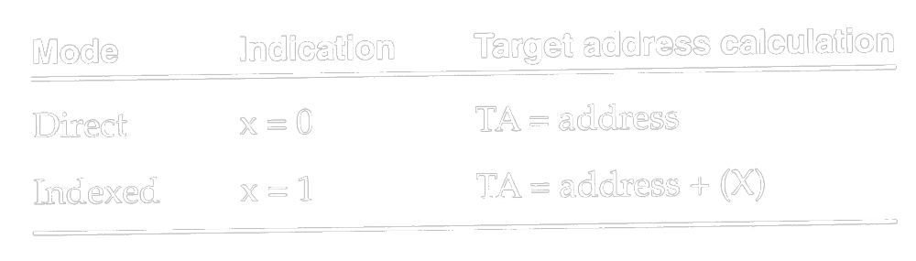
1.3.1 SIC Machine Architecture
Instruction format
  24-bit format
  The flag bit x is used to indicate indexed-addressing mode
Addressing Modes
  There are two addressing modes available
    Indicated by x bit in the instruction
    (X) represents the contents of reg. X
8
1
15
opcode
x
address

Slide 16
1.3.1 SIC Machine Architecture
Instruction set
  Format 3
  Load and store registers (LDA, LDX, STA, STX, etc.)
  Integer arithmetic operations (ADD, SUB, MUL, DIV)
  Compare instruction (COMP)
  Conditional jump instructions (JLT, JEQ, JGT)
  JSUB jumps to the subroutine, placing the return address in register L.
  RSUB returns by jumping to the address contained in register L.

Slide 17
1.3.1 SIC Machine Architecture
I/O
  I/O are performed by transferring 1 byte at a time to or from the rightmost 8 bits of register A.
  Each device is assigned a unique 8-bit code as an operand.
  Test Device (TD): tests whether the addressed device is ready to send or receive
    < ready = not ready
  Read Data (RD)
  Write Data (WD)

Slide 18
1.3.2 SIC/XE Machine Architecture
1 megabytes (1024 KB) in memory
3 additional registers, 24 bits in length
  B 3 Base register; used for addressing
  S 4 General working register
  T 5 General working register
1 additional register, 48 bits in length
  F 6 Floating-point accumulator (48 bits)

Slide 19
1.3.2 SIC/XE Machine Architecture
Data format
  24-bit binary number for integer, 2’s complement for negative values
  48-bit floating-point data type
  The exponent is between 0 and 2047
  f*2^{(e-1024)}
  0: set all bits to 0
1
11
36
S
exponent
fraction

Slide 20
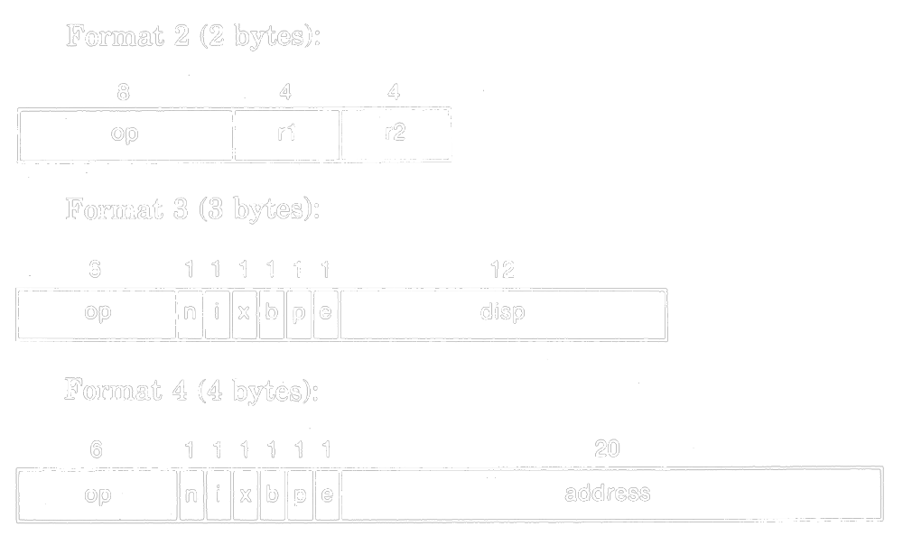

1.3.2 SIC/XE Machine Architecture
Instruction formats
  Relative addressing (相對位址) - format 3 (e=0)
  Extend the address to 20 bits - format 4 (e=1)
  Don’t refer memory at all - formats 1 and 2

Slide 21
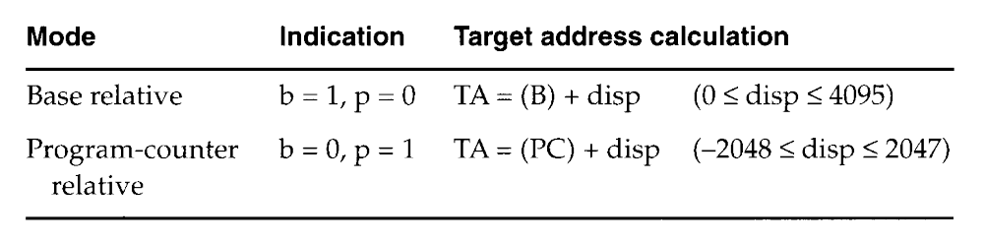
1.3.2 SIC/XE Machine Architecture
Addressing modes
  n i x b p e
  Simple n=0, i=0 (SIC) or n=1, i=1
  Immediate n=0, i=1 TA=Valus
  Indirect n=1, i=0 TA=(Operand)
  Base relative b=1, p=0 TA=(B)+disp
  0 <= disp <= 4095
  PC relative b=0, p=1 TA=(PC)+disp
  -2048 <= disp <= 2047

Slide 22
1.3.2 SIC/XE Machine Architecture
Addressing mode
  Direct b=0, p=0 TA=disp
  Index x=1 TA_{new}=TA_{old}+(X)
  Index+Base relative x=1, b=1, p=0 TA=(B)+disp+(X)
  Index+PC relative x=1, b=0, p=1
  TA=(PC)+disp+(X)
  Index+Direct x=1, b=0, p=0
  Format 4 e=1
Appendix and Fig. 1.1 Example

Slide 23
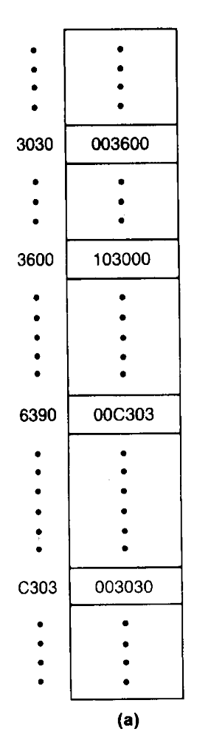
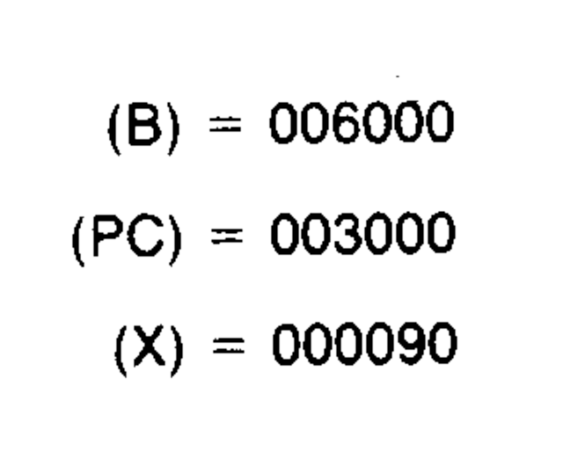
Figure 1.1
Memory address
  00000
  (0000 0000 0000 0000 0000)
  ~FFFFF (Byte)
  (1111 1111 1111 1111 1111)

Slide 24
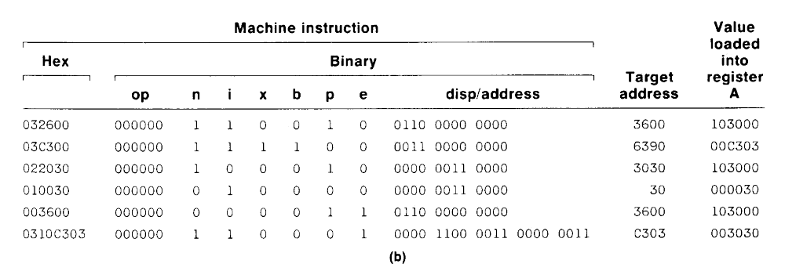

Slide 25
1.3.2 SIC/XE Machine Architecture
Instruction set
  Format 1, 2, 3, or 4
  Load and store registers (LDB, STB, etc.)
  Floating-point arithmetic operations (ADDF, SUBF, MULF, DIVF)
  Register-to-register arithmetic operations (ADDR, SUBR, MULR, DIVR)
  A special supervisor call instruction (SVC) is provided
I/O
  1 byte at a time, TD, RD, and WD
  SIO, TIO, and HIO are used to start, test, and halt the operation of I/O channels.

Slide 26
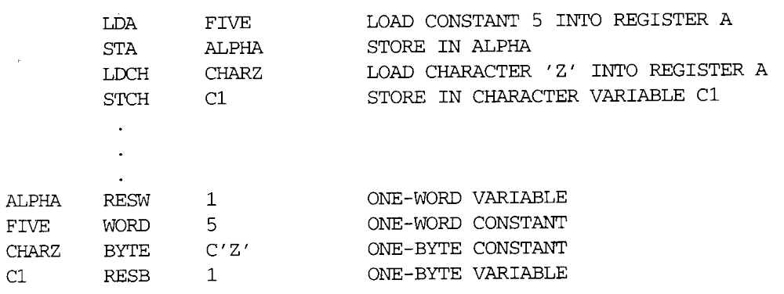
1.3.3 SIC Programming Examples
Sample data movement operations
  No memory-to-memory move instructions (Fig. 1.2)
    LDA five LDA #5
    … …
    five word 5

Slide 27
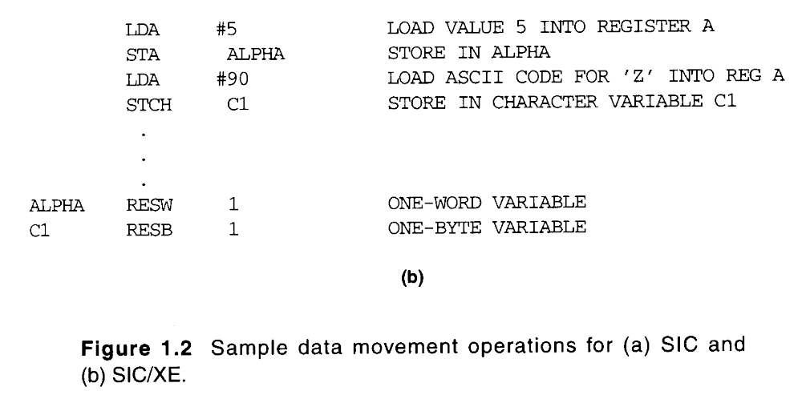
1.3.3 SIC Programming Examples

Slide 28
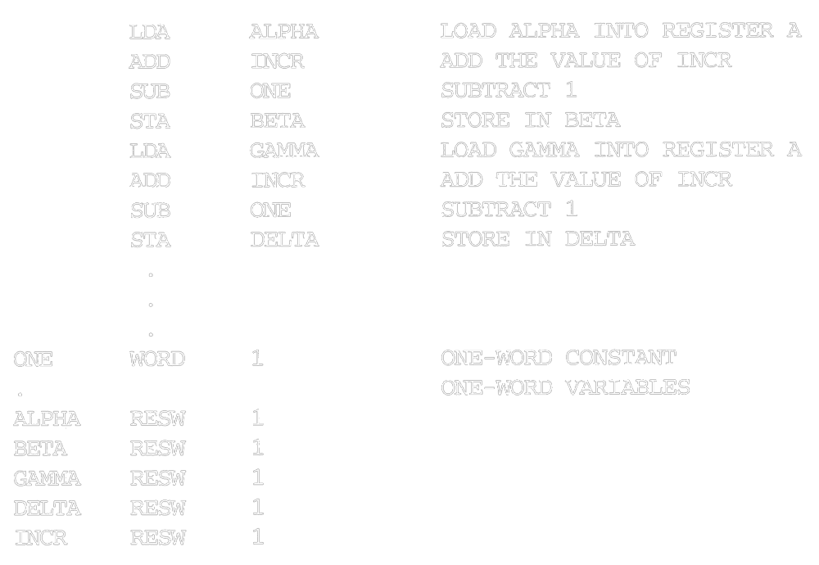
1.3.3 SIC Programming Examples
Sample arithmetic operations
  (ALPHA+INCR-1) assign to BETA (Fig. 1.3)
  (GAMMA+INCR-1) assign to DELTA

Slide 29
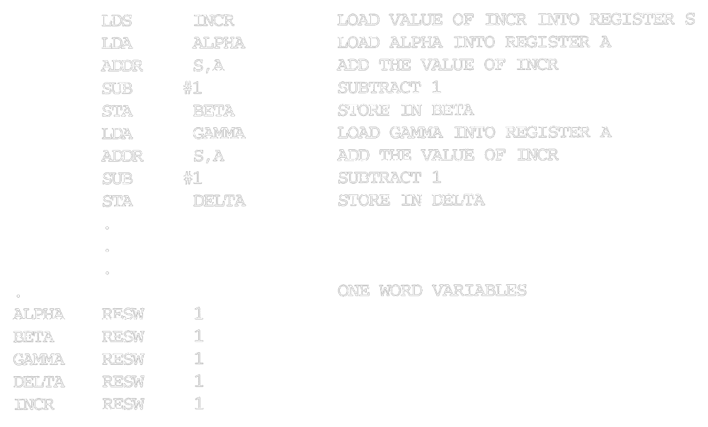
1.3.3 SIC Programming Examples

Slide 30
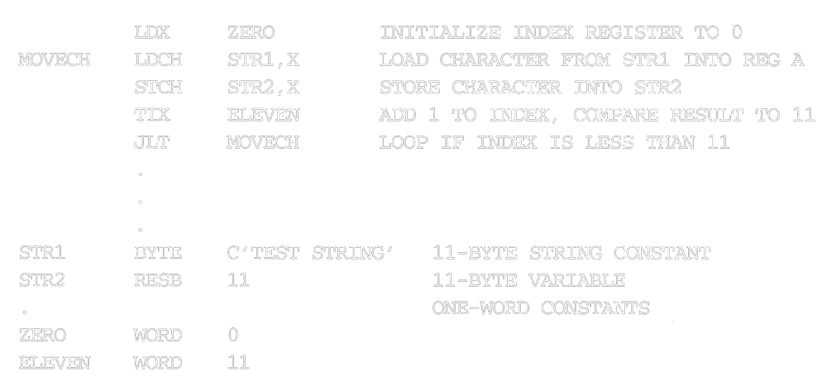
1.3.3 SIC Programming Examples
String copy

Slide 31
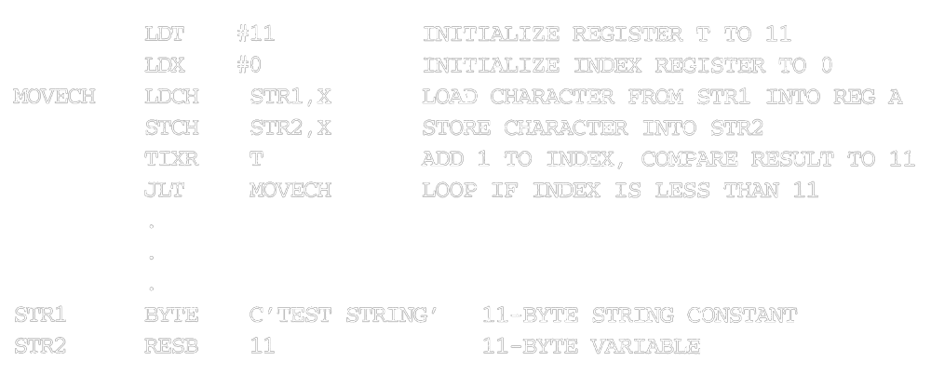
1.3.3 SIC Programming Examples

Slide 32
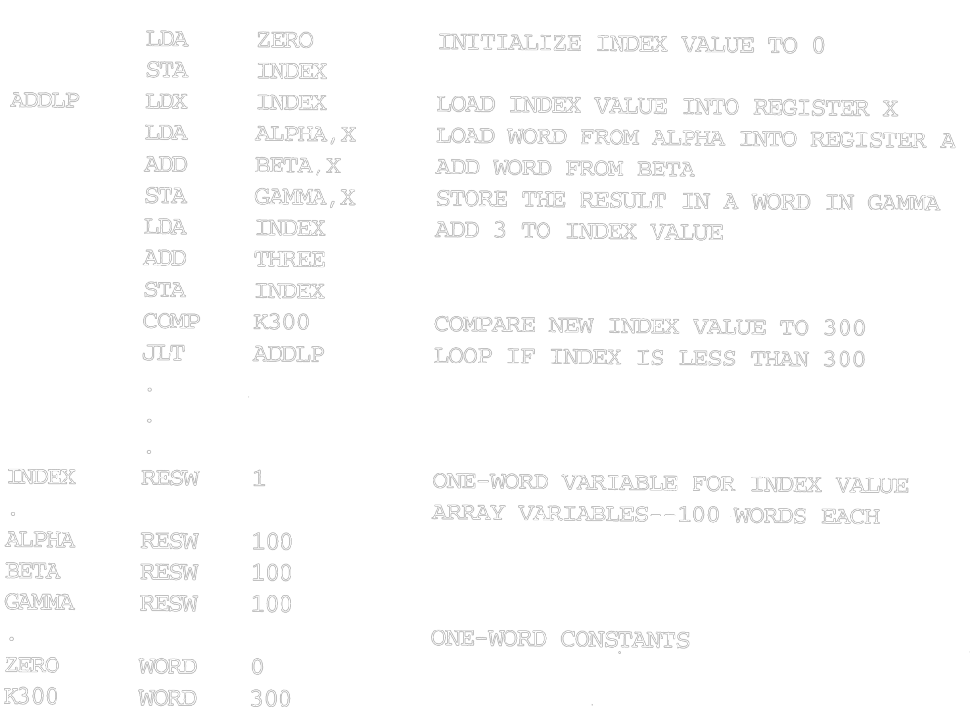
1.3.3 SIC Programming Examples

Slide 33
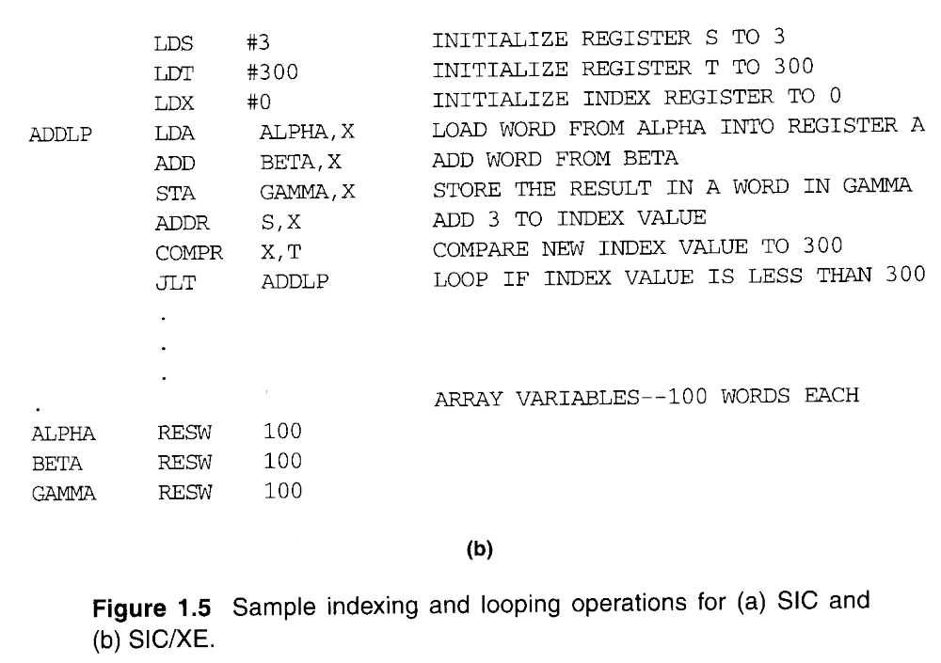
1.3.3 SIC Programming Examples

Slide 34
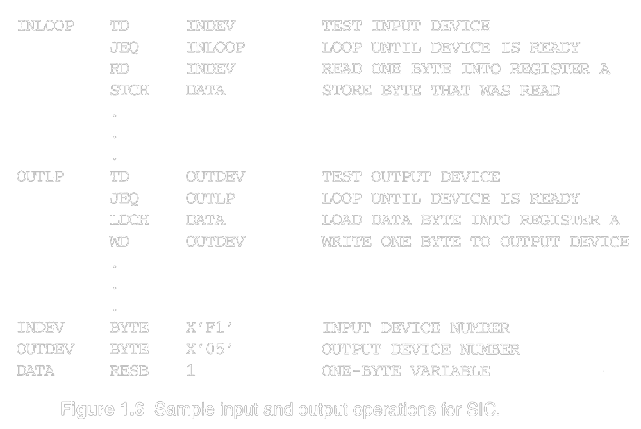
1.3.3 SIC Programming Examples

Slide 35
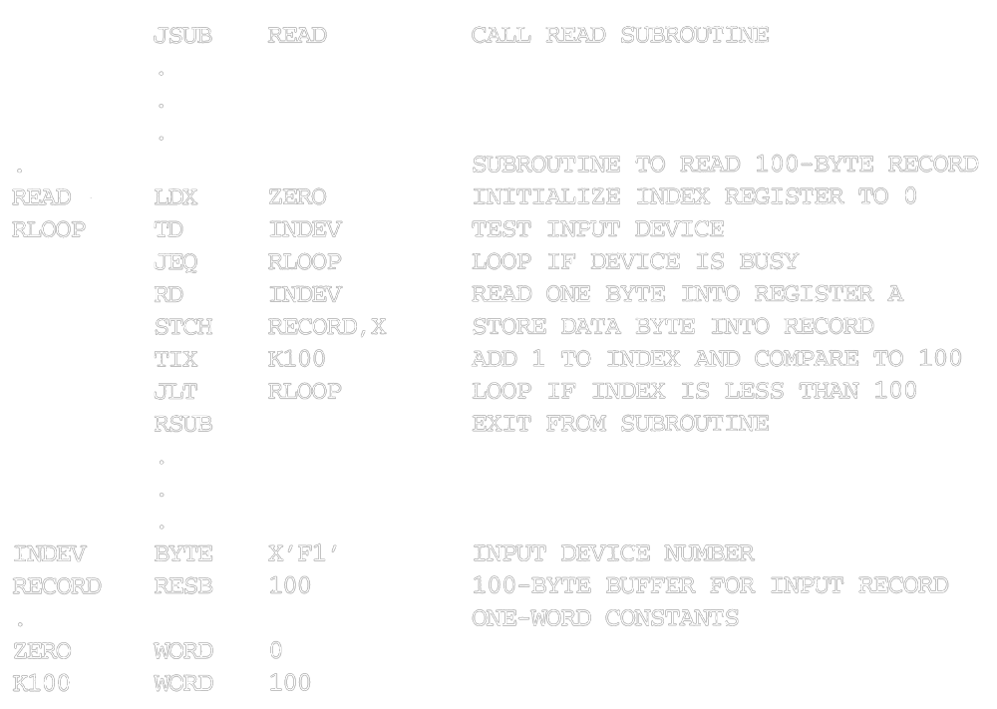
1.3.3 SIC Programming Examples

Slide 36
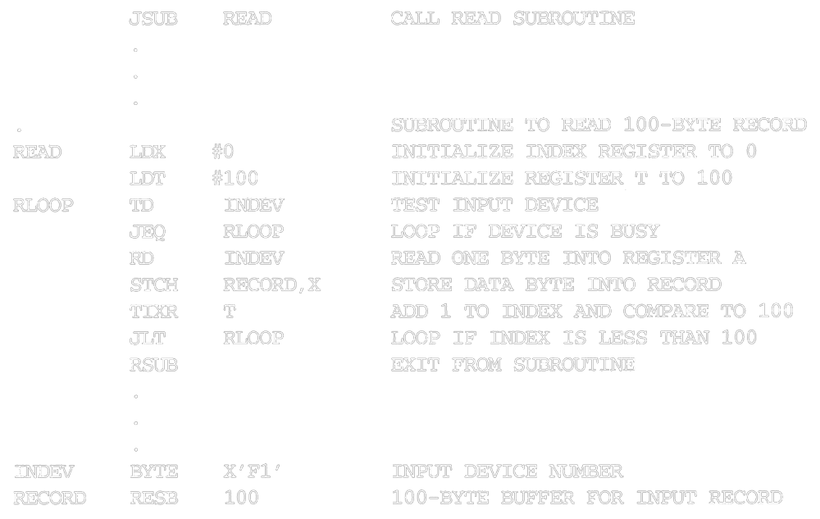
1.3.3 SIC Programming Examples

Slide 37
Traditional (CISC) Machines
Complex Instruction Set Computers (CISC)
  complicated instruction set
  different instruction formats and lengths
  many different addressing modes
  e.g. VAX or PDP-11 from DEC
  e.g. Intel x86 family
Reduced Instruction Set Computer (RISC)

Slide 38
RISC Machines
RISC system
  instruction
    standard, fixed instruction format
    single-cycle execution of most instructions
    memory access is available only for load and store instruction
    other instructions are register-to-register operations
    a small number of machine instructions, and instruction format
  a large number of general-purpose registers
  a small number of addressing modes
  Three RISC machines
    SPARC family
    PowerPC family
    Cray T3E

Slide 39
Chapter 2
Assemblers
Assembler
Linker
Source
Program
Object
Code
Executable
Code
Loader

Slide 40
Outline
2.1 Basic Assembler Functions
  A simple SIC assembler
  Assembler tables and logic
2.2 Machine-Dependent Assembler Features
  Instruction formats and addressing modes
  Program relocation
2.3 Machine-Independent Assembler Features
2.4 Assembler Design Options
  Two-pass
  One-pass
  Multi-pass

Slide 41
2.1 Basic Assembler Functions
Figure 2.1 shows an assembler language program for SIC.
  The line numbers are for reference only.
  Indexing addressing is indicated by adding the modifier “X”
  Lines beginning with “.” contain comments only.
  Reads records from input device (code F1)
  Copies them to output device (code 05)
  At the end of the file, writes EOF on the output device, then RSUB to the operating system

Slide 42
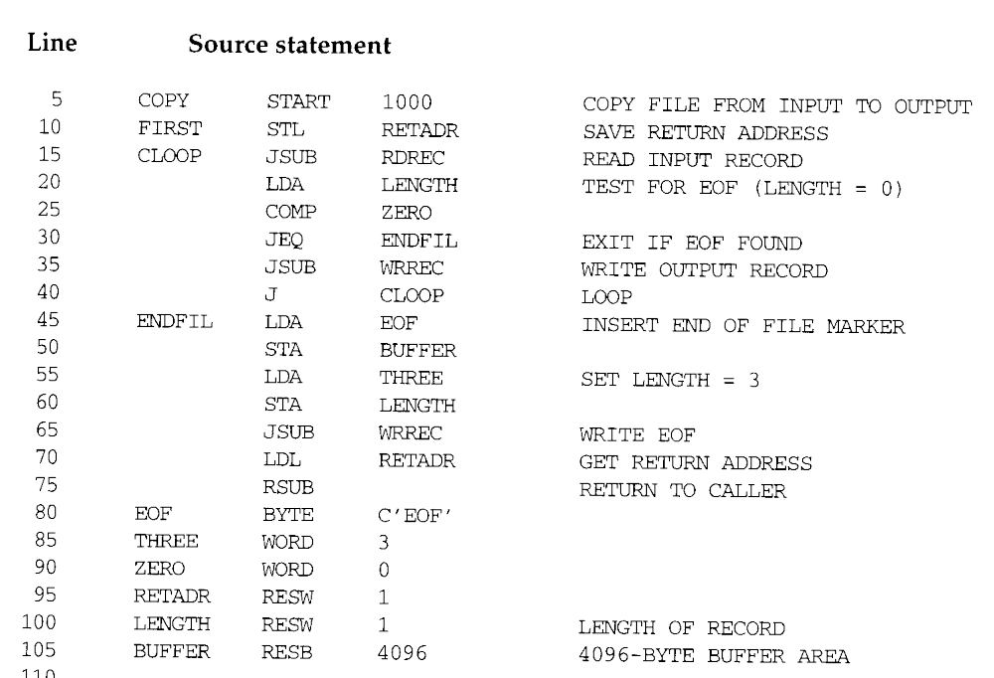

Slide 43
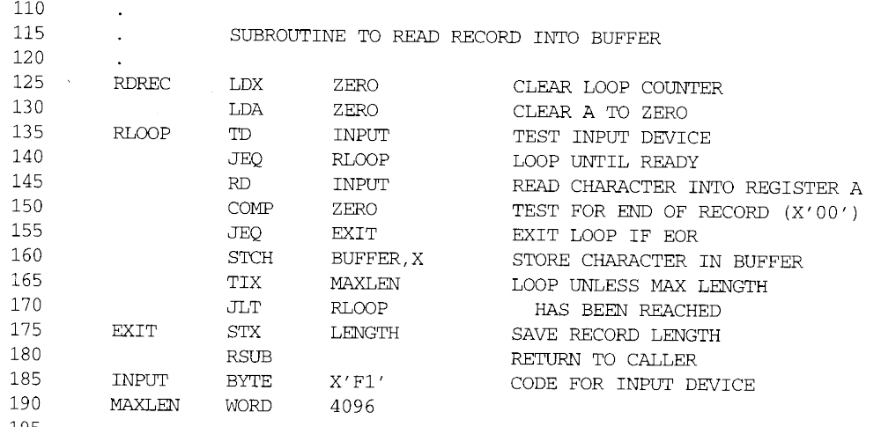

Slide 44
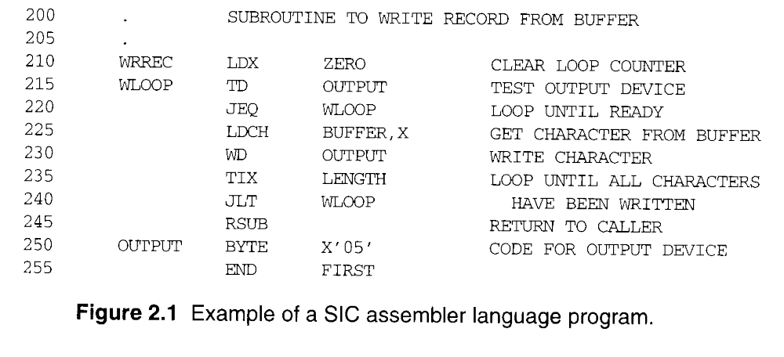

Slide 45
2.1 Basic Assembler Functions
Assembler directives (pseudo-instructions)
  START, END, BYTE, WORD, RESB, RESW.
  These statements are not translated into machine instructions.
  Instead, they provide instructions to the assembler itself.

Slide 46
2.1 Basic Assembler Functions
Data transfer (RD, WD)
  A buffer is used to store record
  Buffering is necessary for different I/O rates
  The end of each record is marked with a null character (00₁₆)
  Buffer length is 4096 Bytes
  The end of the file is indicated by a zero-length record
Subroutines (JSUB, RSUB)
  RDREC, WRREC
  Save link (L) register first before nested jump

Slide 47
2.1.1 A simple SIC Assembler
Figure 2.2 shows the generated object code for each statement.
  Loc gives the machine address in Hex.
  Assume the program starting at address 1000.
Translation functions
  Translate STL to 14.
  Translate RETADR to 1033.
  Build the machine instructions in the proper format (,X).
  Translate EOF to 454F46.
  Write the object program and assembly listing.

Slide 48
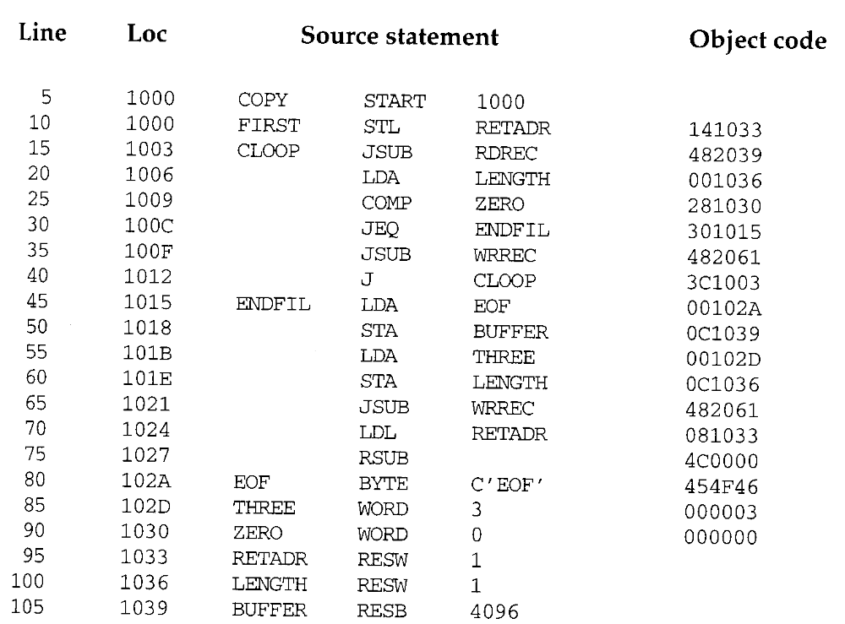

Slide 49
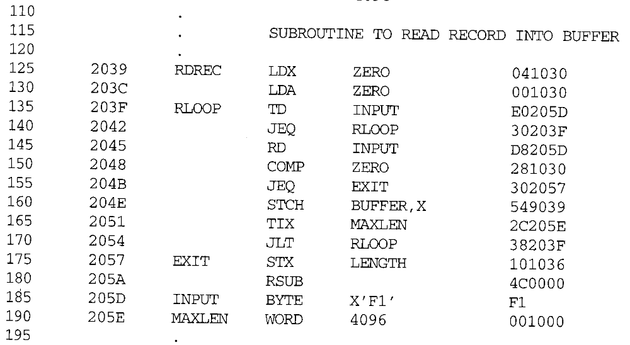

Slide 50
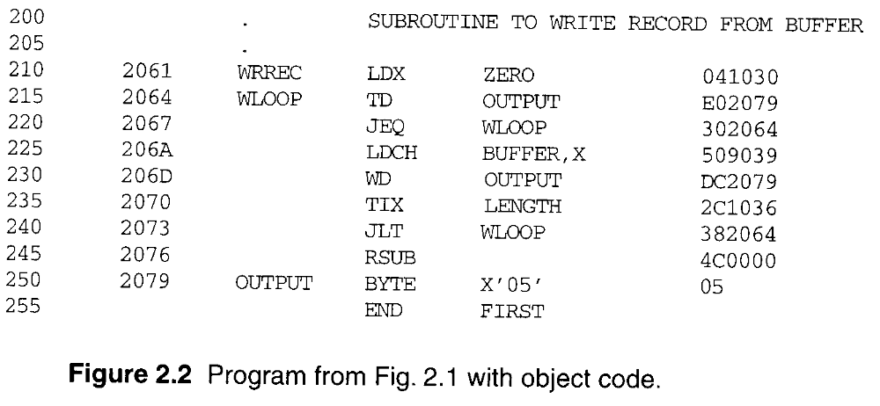

Slide 51
2.1.1 A simple SIC Assembler
A forward reference
  10 1000 FIRST STL RETADR 141033
  A reference to a label (RETADR) that is defined later in the program
  Most assemblers make two passes over the source program
Most assemblers make two passes over source program.
  Pass 1 scans the source for label definitions and assigns address (Loc).
  Pass 2 performs most of the actual translation.

Slide 52
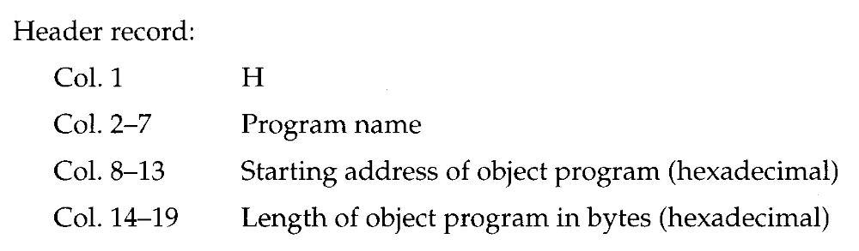
2.1.1 A simple SIC Assembler
The object program (OP) will be loaded into memory for execution.
Three types of records
  Header: program name, starting address, length.
  Text: starting address, length, object code.
  End: address of first executable instruction.

Slide 53
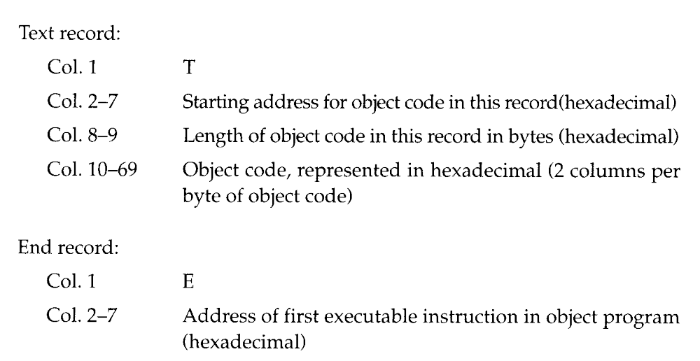
2.1.1 A simple SIC Assembler

Slide 54
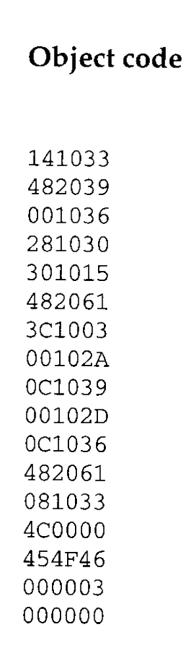
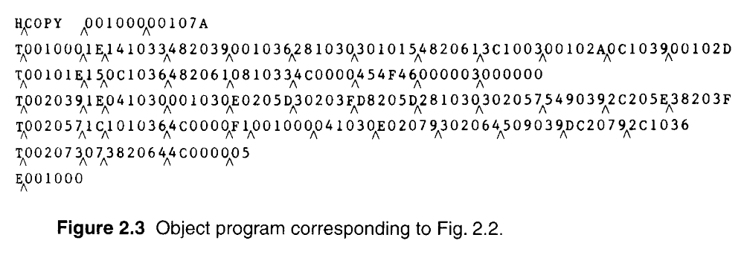
2.1.1 A simple SIC Assembler
The symbol ^ is used to separate fields.
  Figure 2.3
  1E(H)=30(D)=16(D)+14(D)

Slide 55
2.1.1 A simple SIC Assembler
Assembler’s Functions
  Convert mnemonic operation codes to their machine language equivalents
    STL to 14
  Convert symbolic operands (referred label) to their equivalent machine addresses
    RETADR to 1033
  Build the machine instructions in the proper format
  Convert the data constants to internal machine representations
  Write the object program and the assembly listing

Slide 56
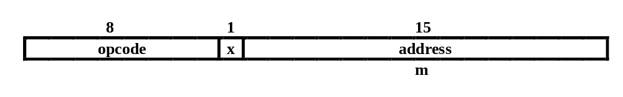
2.1.1 A simple SIC Assembler
Example of Instruction Assemble
  Forward reference
  STCH BUFFER, X
549039
(54)₁₆ 1 (001)₂ (039)₁₆

Slide 57
2.1.1 A simple SIC Assembler
Forward reference
  Reference to a label that is defined later in the program.
Loc Label OP Code Operand
1000 FIRST STL RETADR
1003 CLOOP JSUB RDREC
… … … … 1012 J CLOOP
… … … … 1033 RETADR RESW 1

Slide 58
2.1.1 A simple SIC Assembler
The functions of the two passes assembler.
Pass 1 (define symbol)
  Assign addresses to all statements (generate LOC).
  Save the values (address) assigned to all labels for Pass 2.
  Perform some processing of assembler directives.
Pass 2
  Assemble instructions.
  Generate data values defined by BYTE, WORD.
  Perform processing of assembler directives not done during Pass 1.
  Write the OP (Fig. 2.3) and the assembly listing (Fig. 2.2).

Slide 59
2.1.2 Assembler Tables and Logic
Our simple assembler uses two internal tables: The OPTAB and SYMTAB.
  OPTAB is used to look up mnemonic operation codes and translate them to their machine language equivalents.
    LDA→00, STL→14, …
  SYMTAB is used to store values (addresses) assigned to labels.
    FIRST→1000, COPY→1000, …
Location Counter LOCCTR
  LOCCTR is a variable for assignment addresses.
  LOCCTR is initialized to address specified in START.
  When reach a label, the current value of LOCCTR gives the address to be associated with that label.

Slide 60
2.1.2 Assembler Tables and Logic
The Operation Code Table (OPTAB)
  Contain the mnemonic operation & its machine language equivalents (at least).
  Contain instruction format & length.
  Pass 1, OPTAB is used to look up and validate operation codes.
  Pass 2, OPTAB is used to translate the operation codes to machine language.
  In SIC/XE, assembler search OPTAB in Pass 1 to find the instruction length for incrementing LOCCTR.
  Organize as a hash table (static table).

Slide 61
2.1.2 Assembler Tables and Logic
The Symbol Table (SYMTAB)
  Include the name and value (address) for each label.
  Include flags to indicate error conditions
  Contain type, length.
  Pass 1, labels are entered into SYMTAB, along with assigned addresses (from LOCCTR).
  Pass 2, symbols used as operands are look up in SYMTAB to obtain the addresses.
  Organize as a hash table (static table).
  The entries are rarely deleted from table.
COPY 1000
FIRST 1000
CLOOP 1003
ENDFIL 1015
EOF 1024
THREE 102D
ZERO 1030
RETADR 1033
LENGTH 1036
BUFFER 1039
RDREC 2039

Slide 62
2.1.2 Assembler Tables and Logic
Pass 1 usually writes an intermediate file.
  Contain source statement together with its assigned address, error indicators.
  This file is used as input to Pass 2.
Figure 2.4 shows the two passes of assembler.
  Format with fields LABEL, OPCODE, and OPERAND.
  Denote numeric value with the prefix #.
  #[OPERAND]

Slide 63
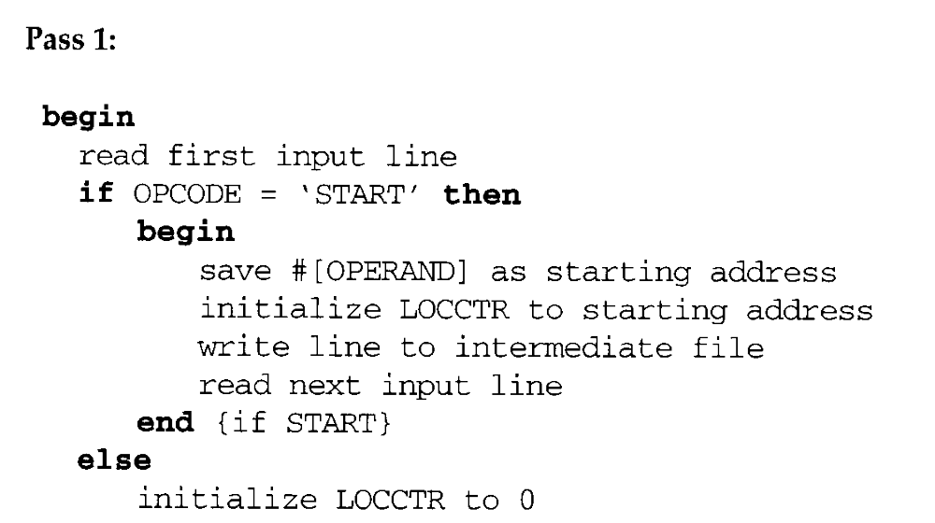

Pass 1

Slide 64
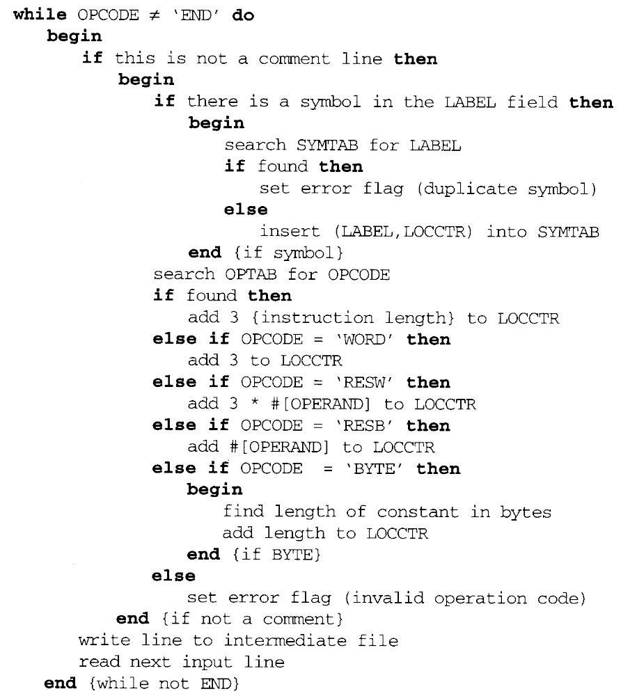

Slide 65
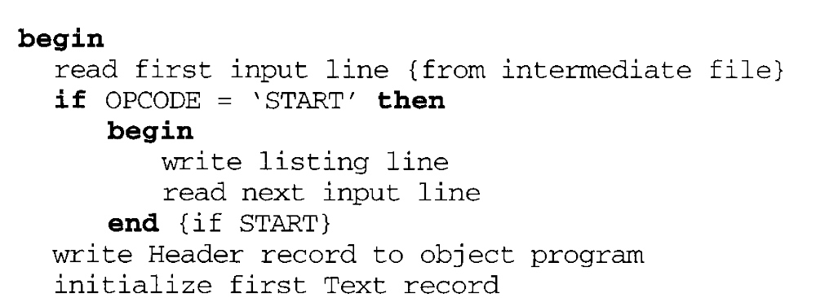
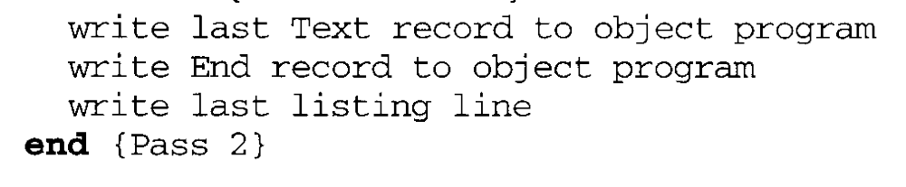
Pass 2

Slide 66
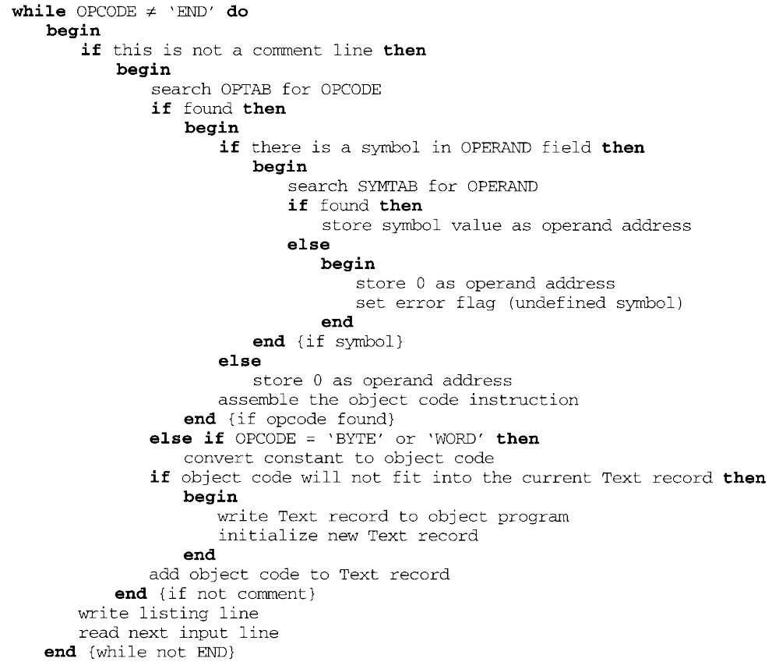

Slide 67
2.2 Machine-Dependent Assembler Features
Indirect addressing
  Adding the prefix @ to operand (line 70).
Immediate operands
  Adding the prefix # to operand (lines 12, 25, 55, 133).
Base relative addressing
  Assembler directive BASE (lines 12 and 13).
Extended format
  Adding the prefix + to OP code (lines 15, 35, 65).
The use of register-register instructions.
  Faster and don’t require another memory reference.

Slide 68
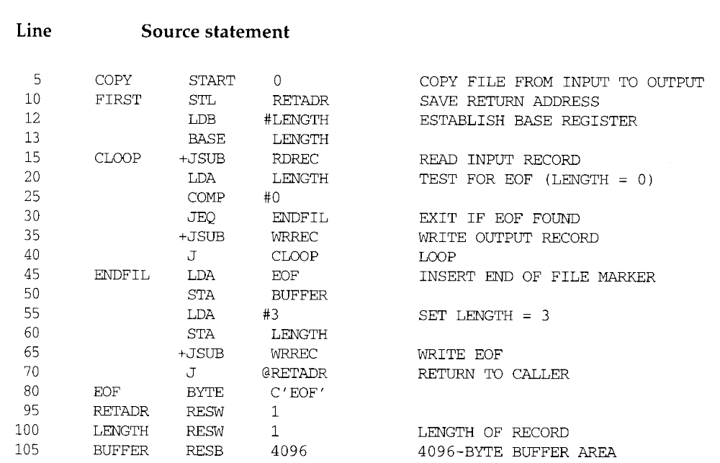
Figure 2.5: First

Slide 69
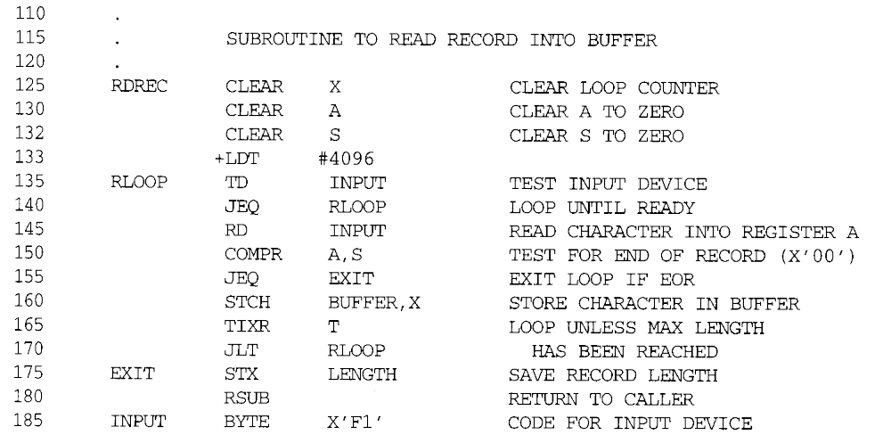
Figure 2.5: RDREC

Slide 70
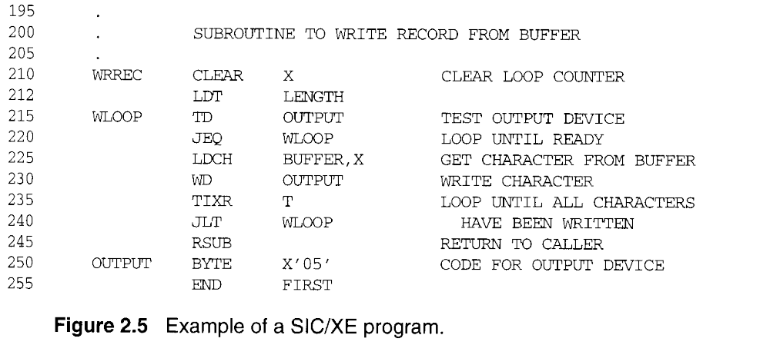
Figure 2.5: WRREC

Slide 71
2.2 Machine-Dependent Assembler
Features
SIC/XE
  PC-relative/Base-relative addressing op m
  Indirect addressing op @m
  Immediate addressing op #c
  Extended format +op m
  Index addressing op m, X
  register-to-register instructions COMPR
  larger memory → multi-programming (program allocation)

Slide 72
2.2 Machine-Dependent Assembler
Features
Register translation
  register name (A, X, L, B, S, T, F, PC, SW) and their values (0, 1, 2, 3, 4, 5, 6, 8, 9)
  preloaded in SYMTAB
Address translation
  Most register-memory instructions use program counter relative or base relative addressing
  Format 3: 12-bit disp (address) field
    Base-relative: 0~4095
    PC-relative: -2048~2047
  Format 4: 20-bit address field (absolute addressing)

Slide 73
2.2.1 Instruction Formats & Addressing Modes
The START statement
  Specifies a beginning address of 0.
Register-register instructions
  CLEAR & TIXR, COMPR
Register-memory instructions are using
  Program-counter (PC) relative addressing
  The program counter is advanced after each instruction is fetched and before it is executed.
  PC will contain the address of the next instruction.
  10 0000 FIRST STL RETADR 17202D
  TA - (PC) = disp = 30 - 3 = 2D

Slide 74
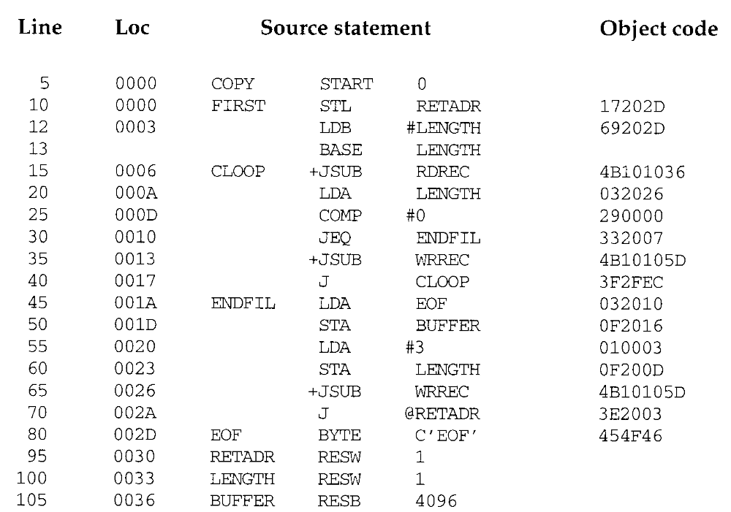

Slide 75
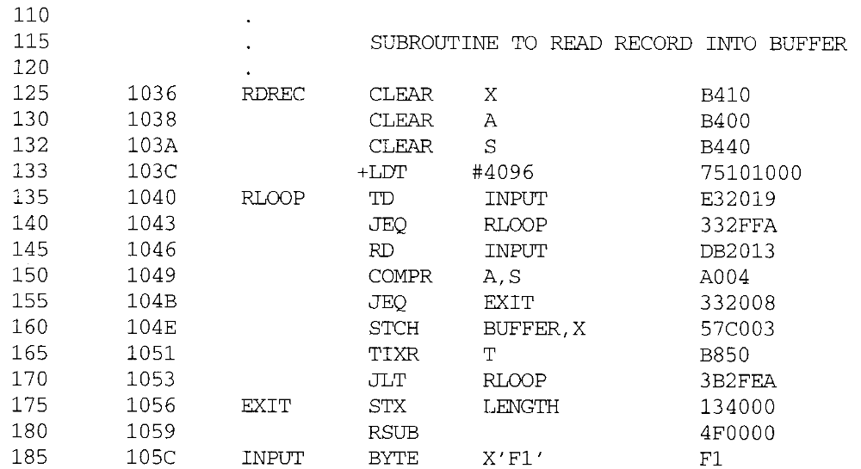

Slide 76
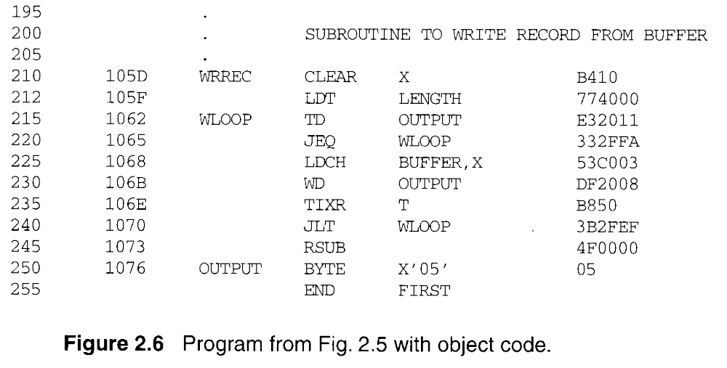

Slide 77
2.2.1 Instruction Formats & Addressing Modes
  40 0017 J CLOOP 3F2FEC
  0006 - 001A = disp = -14
  Base (B), LDB #LENGTH, BASE LENGTH
  160 104E STCH BUFFER, X 57C003
  TA-(B) = 0036 - (B) = disp = 0036-0033 = 0003
Extended instruction
  15 0006 CLOOP +JSUB RDREC 4B101036
Immediate instruction
  55 0020 LDA #3 010003
  133 103C +LDT #4096 75101000
PC relative + indirect addressing (line 70)

Slide 78
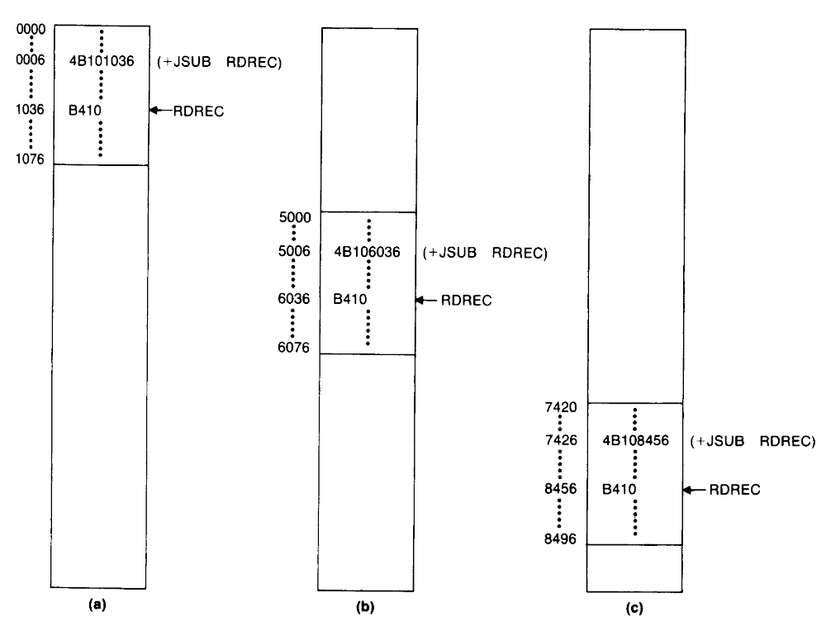
2.2.2 Program Relocation
Absolute program, relocatable program

Slide 79
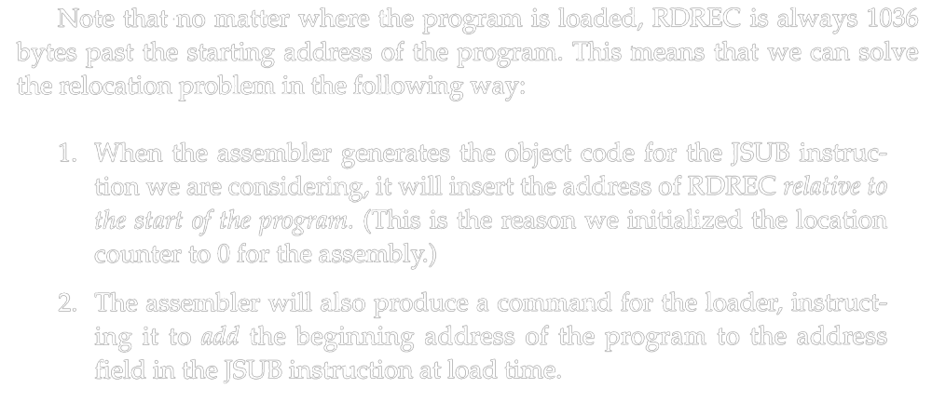
2.2.2 Program Relocation

Slide 80
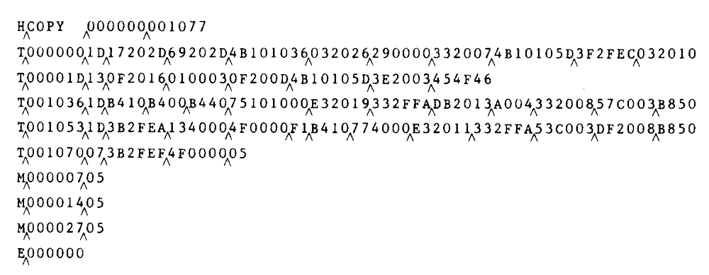
2.2.2 Program Relocation
Modification record (direct addressing)
  1 M
  2-7 Starting location of the address field to be modified, relative to the beginning of the program.
  8-9 Length of the address field to be modified, in half bytes.
  M^0000007^05

Slide 81
2.3 Machine-Independent Assembler Features
Write the value of a constant operand as a part of the instruction that uses it (Fig. 2.9).
A literal is identified with the prefix =
  45 001A ENDFIL LDA =C’EOF’ 032010
  Specifies a 3-byte operand whose value is the character string EOF.
  215 1062 WLOOP TD =X’05’ E32011
  Specifies a 1-byte literal with the hexadecimal value 05

Slide 82
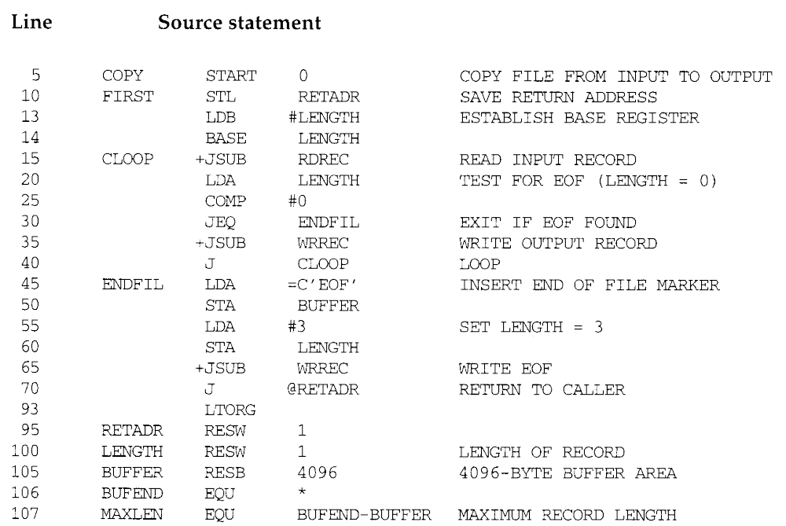

Slide 83
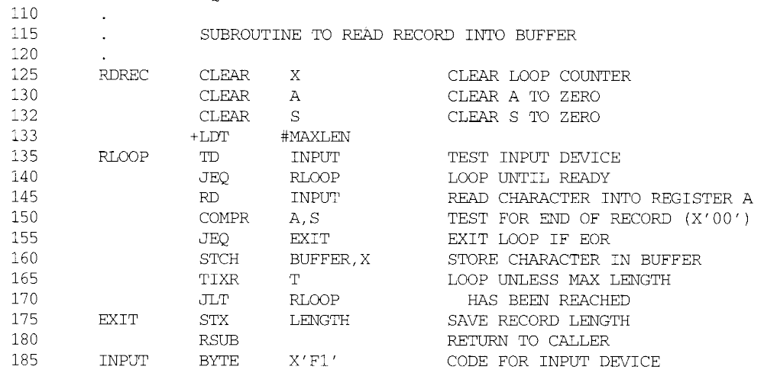
RDREC

Slide 84
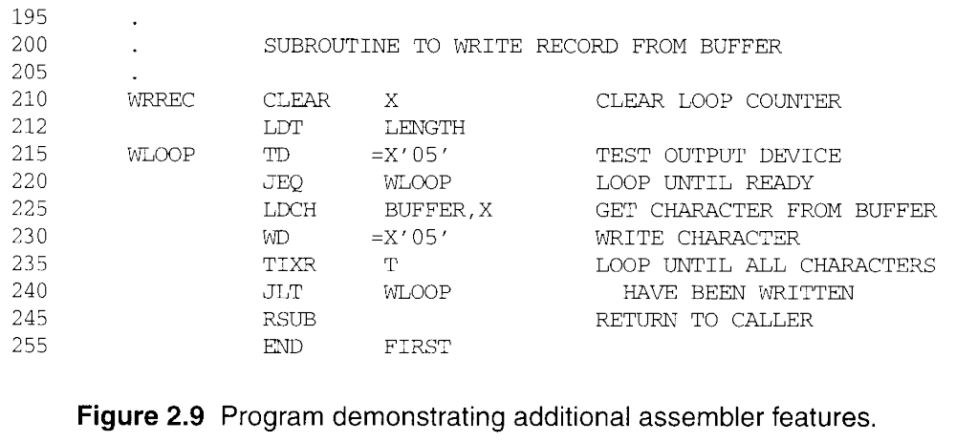
WRREC

Slide 85
2.3.1 Literals
The difference between literal and immediate
  Immediate addressing, the operand value is assembled as part of the machine instruction, no memory reference.
  With a literal, the assembler generates the specified value as a constant at some other memory location. The address of this generated constant is used as the TA for the machine instruction, using PC-relative or base-relative addressing with memory reference.
Literal pools
  At the end of the program (Fig. 2.10).
  Assembler directive LTORG, it creates a literal pool that contains all of the literal operands used since the previous LTORG.

Slide 86
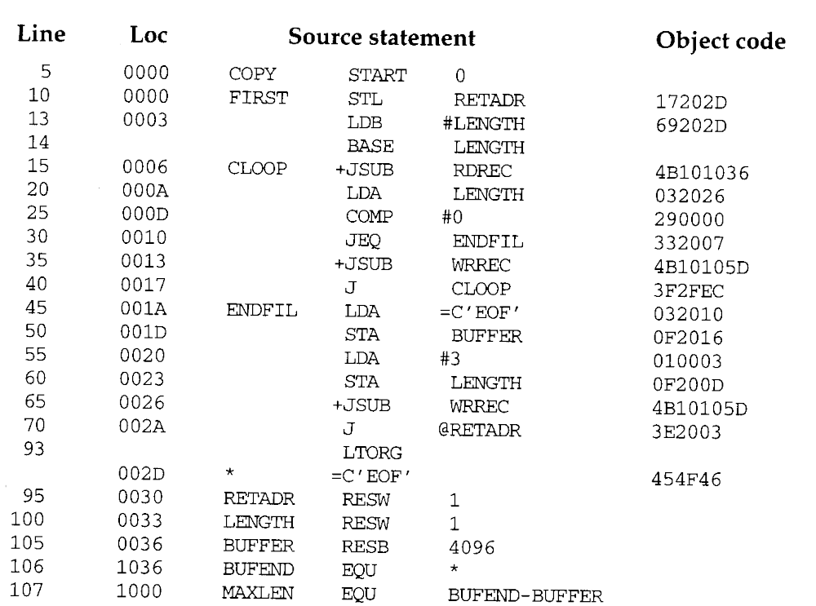

Slide 87
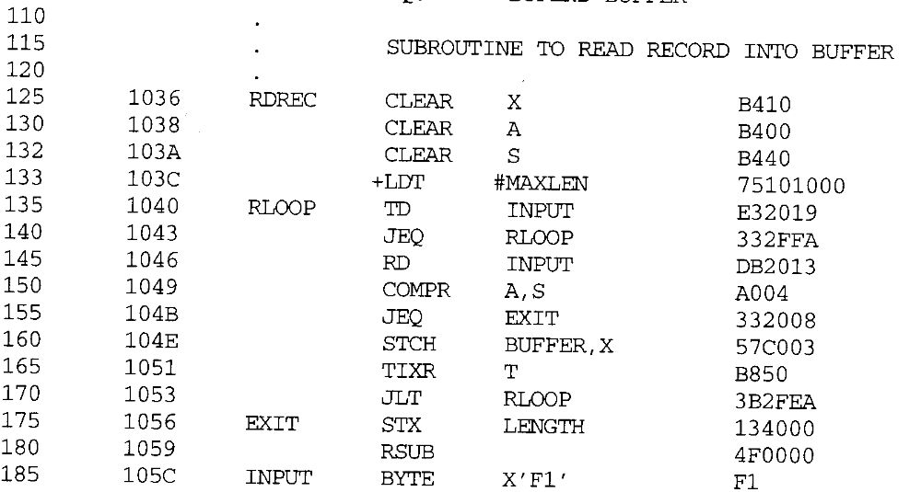
RDREC

Slide 88
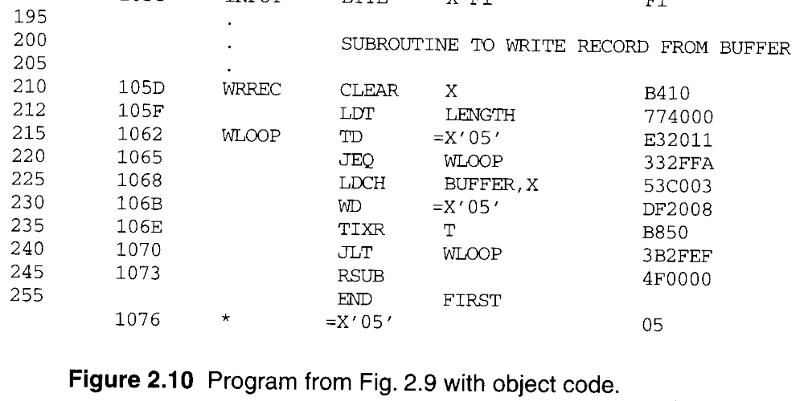
WRREC

Slide 89
2.3.1 Literals
When to use LTORG (page 69, 4th paragraph)
  The literal operand would be placed too far away from the instruction referencing.
  Cannot use PC-relative addressing or Base-relative addressing to generate Object Program.
Most assemblers recognize duplicate literals.
  By comparison of the character strings defining them.
  =C’EOF’ and =X’454F46’

Slide 90
2.3.1 Literals
Allow literals that refer to the current value of the location counter.
  Such literals are sometimes useful for loading base registers.
  LDB =*
  ; register B=beginning address of statement=current LOC
  BASE *
  ; for base relative addressing
If a literal =* appeared on line 13 and 55
  Specify an operand with value 0003 (Loc) and 0020 (Loc).

Slide 91
2.3.1 Literals
Literal table (LITTAB)
  Contains the literal name (=C’EOF’), the operand value (454F46) and length (3), and the address (002D).
  Organized as a hash table.
  Pass 1, the assembler searches LITTAB for the specified literal name.
  Pass 1 encounters a LTORG statement or the end of the program, the assembler makes a scan of the literal table.
  Pass 2, the operand address for use in generating OC is obtained by searching LITTAB.

Slide 92
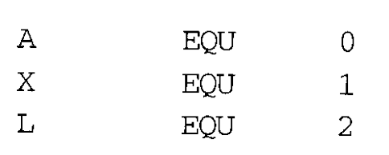
2.3.2 Symbol-Defining Statements
Allow the programmer to define symbols and specify their values.
  Assembler directive EQU.
  Improved readability in place of numeric values.
  +LDT #4096
  MAXLEN EQU 4096
  +LDT #MAXLEN
Use EQU in defining mnemonic names for registers.
  Registers A, X, L can be used by numbers 0, 1, 2.
  RMO A, X

Slide 93
2.3.2 Symbol-Defining Statements
The standard names reflect the usage of the registers.
  BASE EQU R1
  COUNT EQU R2
  INDEX EQU R3
Assembler directive ORG
  Use to indirectly assign values to symbols.
  ORG value
  The assembler resets its LOCCTR to the specified value.
  ORG can be useful in label definition.

Slide 94

2.3.2 Symbol-Defining Statements
The location counter is used to control assignment of storage in the object program
  In most cases, altering its value would result in an incorrect assembly.
ORG is used
  SYMBOL is 6-byte, VALUE is 3-byte, and FLAGS is 2-byte.

Slide 95
2.3.2 Symbol-Defining Statements
  STAB SYMBOL VALUE FLAGS
  (100 entries) 6 3 2
  1000 STAB RESB 1100
  1000 SYMBOL EQU STAB
  1006 VALUE EQU STAB +6
  1009 FLAGS EQU STAB +9
Use LDA VALUE,X to fetch the VALUE field form the table entry indicated by the contents of register X.

Slide 96
2.3.2 Symbol-Defining Statements
  STAB SYMBOL VALUE FLAGS
  (100 entries) 6 3 2
  1000 STAB RESB 1100
  ORG STAB
  1000 SYMBOL RESB 6
  1006 VALUE RESW 1
  1009 FLAGS RESB 2
  ORG STAB+1100

Slide 97
2.3.2 Symbol-Defining Statements
All terms used to specify the value of the new symbol --- must have been defined previously in the program.
  BETA EQU ALPHA
  ALPHA RESW 1
  Need 2 passes

Slide 98
2.3.2 Symbol-Defining Statements
All symbols used to specify new location counter value must have been previously defined.
  ORG ALPHA
  BYTE1 RESB 1
  BYTE2 RESB 1
  BYTE3 RESB 1
  ORG
  ALPHA RESW 1
Forward reference
  ALPHA EQU BETA
  BETA EQU DELTA
  DELTA RESW 1
  Need 3 passes

Slide 99
2.3.3 Expressions
Allow arithmetic expressions formed
  Using the operators +, -, *, /.
  Division is usually defined to produce an integer result.
  Expression may be constants, user-defined symbols, or special terms.
  106 1036 BUFEND EQU *
  Gives BUFEND a value that is the address of the next byte after the buffer area.
Absolute expressions or relative expressions
  A relative term or expression represents some value (S+r), S: starting address, r: the relative value.

Slide 100

2.3.3 Expressions
  107 1000 MAXLEN EQU BUFEND-BUFFER
  Both BUFEND and BUFFER are relative terms.
  The expression represents absolute value: the difference between the two addresses.
  Loc =1000 (Hex)
  The value that is associated with the symbol that appears in the source statement.
  BUFEND+BUFFER, 100-BUFFER, 3*BUFFER represent neither absolute values nor locations.
Symbol tables entries

Slide 101
2.3.4 Program Blocks
The source program logically contained main, subroutines, data areas.
  In a single block of object code.
More flexible (Different blocks)
  Generate machine instructions (codes) and data in a different order from the corresponding source statements.
Program blocks
  Refer to segments of code that are rearranged within a single object program unit.
Control sections
  Refer to segments of code that are translated into independent object program units.

Slide 102
2.3.4 Program Blocks
Three blocks, Figure 2.11
  Default, CDATA, CBLKS.
Assembler directive USE
  Indicates which portions of the source program blocks.
  At the beginning of the program, statements are assumed to be part of the default block.
  Lines 92, 103, 123, 183, 208, 252.
Each program block may contain several separate segments.
  The assembler will rearrange these segments to gather together the pieces of each block.

Slide 103

Main

Slide 104

RDREC

Slide 105

WRREC

Slide 106
2.3.4 Program Blocks
Pass 1, Figure 2.12
  A separate location counter for each program block.
  The location counter for a block is initialized to 0 when the block is first begun.
  Assign each block a starting address in the object program (location 0).
  Labels, block name or block number, relative addr.
  Working table
  Block name Block number Address Length
  (default) 0 0000 0066 (0~65)
  CDATA 1 0066 000B (0~A)
  CBLKS 2 0071 1000 (0~0FFF)

Slide 107


Slide 108


Slide 109


Slide 110
2.3.4 Program Blocks
Pass 2, Figure 2.12
  The assembler needs the address for each symbol relative to the start of the object program.
  Loc shows the relative address and block number.
  Notice that the value of the symbol MAXLEN (line 70) is shown without a block number.
  20 0006 0 LDA LENGTH 032060
  0003(CDATA) +0066 =0069 =TA
  using program-counter relative addressing
  TA - (PC) =0069-0009 =0060 =disp

Slide 111
2.3.4 Program Blocks
Separation of the program into blocks.
  Because the large buffer is moved to the end of the object program.
  No longer need extended format, base register, simply a LTORG statement.
  No need Modification records.
  Improve program readability.
Figure 2.13
  Reflect the starting address of the block as well as the relative location of the code within the block.
Figure 2.14
  Loader simply loads the object code from each record at the dictated.
  CDATA(1) & CBLKS(1) are not actually present in OP.

Slide 112

2.3.4 Program Blocks

Slide 113


Slide 114
2.3.5 Control Sections & Program Linking
Control section
  Handling of programs that consist of multiple control sections.
  A part of the program.
  Can be loaded and relocated independently.
  Different control sections are most often used for subroutines or other logical subdivisions of a program.
  The programmer can assemble, load, and manipulate each of these control sections separately.
  Flexibility.
  Linking control sections together.

Slide 115
2.3.5 Control Sections & Program Linking
External references
  Instructions in one control section might need to refer to instructions or data located in another section.
Figure 2.15, multiple control sections.
  Three sections, main COPY, RDREC, WRREC.
  Assembler directive CSECT.
  EXTDEF and EXTREF for external symbols.
  The order of symbols is not significant.
  COPY START 0
  EXTDEF BUFFER, BUFEND, LENGTH
  EXTREF RDREC, WRREC

Slide 116


Slide 117


Slide 118


Slide 119
2.3.5 Control Sections & Program Linking
Figure 2.16, the generated object code.
  15 0003 CLOOP +JSUB RDREC 4B100000
  160 0017 +STCH BUFFER,X 57900000
  RDREC is an external reference.
  The assembler has no idea where the control section containing RDREC will be loaded, so it cannot assemble the address.
  The proper address to be inserted at load time.
  Must use extended format instruction for external reference (M records are needed).
  190 0028 MAXLEN WORD BUFEND-BUFFER
  An expression involving two external references.

Slide 120


Slide 121


Slide 122


Slide 123
2.3.5 Control Sections & Program Linking
  The loader will add to this data area with the address of BUFEND and subtract from it the address of BUFFER. (COPY and RDREC)
  Line 190 and 107, in 107, the symbols BUFEND and BUFFER are defined in the same section.
  The assembler must remember in which control section a symbol is defined.
  The assembler allows the same symbol to be used in different control sections, lines 107 and 190.
Figure 2.17, two new records.
  Defined record for EXTDEF, relative address.
  Refer record for EXTREF.

Slide 124


Slide 125

2.3.5 Control Sections & Program Linking
Modification record
  M
  Starting address of the field to be modified, relative to the beginning of the control section (Hex).
  Length of the field to be modified, in half-bytes.
  Modification flag (+ or -).
  External symbol.
  M^000004^05+RDREC
  M^000028^06+BUFEND
  M^000028^06-BUFFER
Use Figure 2.8 for program relocation.

Slide 126



Slide 127


Slide 128
2.4 Assembler Design Options
2.4.1 Two-Pass Assembler
Most assemblers
  Processing the source program into two passes.
  The internal tables and subroutines that are used only during Pass 1.
  The SYMTAB, LITTAB, and OPTAB are used by both passes.
The main problems to assemble a program in one pass involves forward references.

Slide 129
2.4.2 One-Pass Assemblers
Eliminate forward references
  Data items are defined before they are referenced.
  But, forward references to labels on instructions cannot be eliminated as easily.
  Prohibit forward references to labels.
Two types of one-pass assembler. (Fig. 2.18)
  One type produces object code directly in memory for immediate execution.
  The other type produces the usual kind of object program for later execution.

Slide 130


Slide 131


Slide 132


Slide 133
2.4.2 One-Pass Assemblers
Load-and-go one-pass assembler
  The assembler avoids the overhead of writing the object program out and reading it back in.
  The object program is produced in memory, the handling of forward references becomes less difficult.
  Figure 2.19(a), shows the SYMTAB after scanning line 40 of the program in Figure 2.18.
  Since RDREC was not yet defined, the instruction was assembled with no value assigned as the operand address (denote by ----).

Slide 134


Slide 135


Slide 136
2.4.2 One-Pass Assemblers
Load-and-go one-pass assembler
  RDREC was then entered into SYMTAB as an undefined symbol, the address of the operand field of the instruction (2013) was inserted.
  Figure 2.19(b), when the symbol ENDFIL was defined (line 45), the assembler placed its value in the SYMTAB entry; it then inserted this value into the instruction operand field (201C).
  At the end of the program, all symbols must be defined without any * in SYMTAB.
  For a load-and-go assembler, the actual address must be known at assembly time.

Slide 137
2.4.2 One-Pass Assemblers
Another one-pass assembler by generating OP
  Generate another Text record with correct operand address.
  When the program is loaded, this address will be inserted into the instruction by the action of the loader.
  Figure 2.20, the operand addresses for the instructions on lines 15, 30, and 35 have been generated as 0000.
  When the definition of ENDFIL is encountered on line 45, the third Text record is generated, the value 2024 is to be loaded at location 201C.
  The loader completes forward references.

Slide 138


Slide 139
2.4.2 One-Pass Assemblers
In this section, simple one-pass assemblers handled absolute programs (SIC example).

Slide 140

2.4.3 Multi-Pass Assemblers
Use EQU, any symbol used on the RHS be defined previously in the source.
  ALPHA EQU BETA
  BETA EQU DELTA
  DELTA RESW 1
  Need 3 passes!
Figure 2.21, multi-pass assembler

Slide 141

2.4.3 Multi-Pass Assemblers

Slide 142

2.4.3 Multi-Pass Assemblers

Slide 143

2.4.3 Multi-Pass Assemblers

Slide 144

2.4.3 Multi-Pass Assemblers

Slide 145

2.4.3 Multi-Pass Assemblers

Slide 146
Chapter 3
Loaders and Linkers
Assembler
Linker
Source
Program
Object
Code
Executable
Code
Loader

Slide 147
3.1 Basic Loader Functions
In Chapter 2, we discussions
  Loading: brings the OP into memory for execution
  Relocating: modifies the OP so that it can be loaded at an address different form the location originally specified.
  Linking: combines two or more separate OP
In Chapter 3, we will discussion
  A loader brings an object program into memory and starting its execution.
  A linker performs the linking operations and a separate loader to handle relocation and loading.

Slide 148

3.1 Basic Loader Functions
3.1.1 Design of an Absolute Loader
Absolute loader, in Figures 3.1 and 3.2.
  Does not perform linking and program relocation.
  The contents of memory locations for which there is no Text record are shown as xxxx.
  Each byte of assembled code is given using its Hex representation in character form.

Slide 149
3.1.1 Design of an Absolute Loader
Absolute loader, in Figure 3.1 and 3.2.
  STL instruction, pair of characters 14, when these are read by loader, they will occupy two bytes of memory.
  14 (Hex 31 34) ----> 00010100 (one byte)
  For execution, the operation code must be store in a single byte with hexadecimal value 14.
  Each pair of bytes must be packed together into one byte.
  Each printed character represents one half-byte.

Slide 150


Slide 151


Slide 152
3.1.2 A Simple Bootstrap Loader
A bootstrap loader, Figure 3.3.
  Loads the first program to be run by the computer--- usually an operating system.
  The bootstrap itself begins at address 0 in the memory.
  It loads the OS or some other program starting at address 80.

Slide 153
3.1.2 A Simple Bootstrap Loader
A bootstrap loader, Figure 3.3.
  Each byte of object code to be loaded is represented on device F1 as two Hex digits (by GETC subroutines).
  The ASCII code for the character 0 (Hex 30) is converted to the numeric value 0.
  The object code from device F1 is always loaded into consecutive bytes of memory, starting at address 80.

Slide 154


Slide 155


Slide 156
3.2 Machine-Dependent Loader Features
Absolute loader has several potential disadvantages.
  The actual address at which it will be loaded into memory.
  Cannot run several independent programs together, sharing memory between them.
  It difficult to use subroutine libraries efficiently.
More complex loader.
  Relocation
  Linking
  Linking loader

Slide 157
3.2.1 Relocation
Relocating loaders, two methods:
  Modification record (for SIC/XE)
  Relocation bit (for SIC)

Slide 158


Slide 159


Slide 160


Slide 161
3.2.1 Relocation
Modification record, Figure 3.4 and 3.5.
  To described each part of the object code that must be changed when the program is relocated.
  The extended format instructions on lines 15, 35, and 65 are affected by relocation. (absolute addressing)
  In this example, all modifications add the value of the symbol COPY, which represents the starting address.
  Not well suited for standard version of SIC, all the instructions except RSUB must be modified when the program is relocated. (absolute addressing)

Slide 162


Slide 163
3.2.1 Relocation
Figure 3.6 needs 31 Modification records.
Relocation bit, Figure 3.6 and 3.7.
  A relocation bit associated with each word of object code.
  The relocation bits are gathered together into a bit mask following the length indicator in each Text record.
  If bit=1, the corresponding word of object code is relocated.

Slide 164


Slide 165


Slide 166


Slide 167
3.2.1 Relocation
Relocation bit, Figure 3.6 and 3.7.
  In Figure 3.7, T000000^1E^FFC^ (111111111100) specifics that all 10 words of object code are to be modified.
  On line 210 begins a new Text record even though there is room for it in the preceding record.
  Any value that is to be modified during relocation must coincide with one of these 3-byte segments so that it corresponding to a relocation bit.
  Because of the 1-byte data value generated form line 185, this instruction must begin a new Text record in object program.

Slide 168

1111 1111 1100

Slide 169
3.2.2 Program Linking
In Section 2.3.5 showed a program made up of three controls sections.
  Assembled together or assembled independently.

Slide 170
3.2.2 Program Linking
Consider the three programs in Fig. 3.8 and 3.9.
  Each of which consists of a single control section.
  A list of items, LISTA---ENDA, LISTB---ENDB, LISTC---ENDC.
  Note that each program contains exactly the same set of references to these external symbols.
  Instruction operands (REF1, REF2, REF3).
  The values of data words (REF4 through REF8).
  Not involved in the relocation and linking are omitted.

Slide 171


Slide 172


Slide 173


Slide 174


Slide 175


Slide 176


Slide 177
3.2.2 Program Linking
REF1, LDA LISTA 03201D 03100000
  In the PROGA, REF1 is simply a reference to a label.
  In the PROGB and PROGC, REF1 is a reference to an external symbols.
  Need use extended format, Modification record.
REF2 and REF3.
  LDT LISTB+4 772027 77100004
  LDX #ENDA-LISTA 050014 05100000

Slide 178
3.2.2 Program Linking
REF4 through REF8,
  WORD ENDA-LISTA+LISTC 000014+000000
Figure 3.10(a) and 3.10(b)
  Shows these three programs as they might appear in memory after loading and linking.
  PROGA 004000, PROGB 004063, PROGC 0040E2.
  REF4 through REF8 in the same value.
  For the references that are instruction operands, the calculated values after loading do not always appear to be equal.
  Target address, REF1 4040.

Slide 179


Slide 180


Slide 181




Slide 182


Slide 183
3.2.3 Algorithm and Data Structure for a Linking Loader
A linking loader usually makes two passes
  Pass 1 assigns addresses to all external symbols.
  Pass 2 performs the actual loading, relocation, and linking.
  The main data structure is ESTAB (hashing table).

Slide 184
3.2.3 Algorithm and Data Structure for a Linking Loader
A linking loader usually makes two passes
  ESTAB is used to store the name and address of each external symbol in the set of control sections being loaded.
  Two variables PROGADDR and CSADDR.
  PROGADDR is the beginning address in memory where the linked program is to be loaded.
  CSADDR contains the starting address assigned to the control section currently being scanned by the loader.

Slide 185
3.2.3 Algorithm and Data Structure for a Linking Loader
The linking loader algorithm, Fig 3.11(a) & (b).
  In Pass 1, concerned only Header and Defined records.
  CSADDR+CSLTH = the next CSADDR.
  A load map is generated.
  In Pass 2, as each Text record is read, the object code is moved to the specified address (plus the current value of CSADDR).
  When a Modification record is encountered, the symbol whose value is to be used for modification is looked up in ESTAB.
  This value is then added to or subtracted from the indicated location in memory.

Slide 186


Slide 187


Slide 188
3.2.3 Algorithm and Data Structure for a Linking Loader
The algorithm can be made more efficient.
  A reference number, is used in Modification records.
  The number 01 to the control section name.
  Figure 3.12, the main advantage of this reference-number mechanism is that it avoids multiple searches of ESTAB for the same symbol during the loading of a control section.

Slide 189


Slide 190


Slide 191


Slide 192
3.3 Machine-Independent Loader Features
3.3.1 Automatic Library Search
Many linking loaders
  Can automatically incorporate routines form a subprogram library into the program being loaded.
  A standard system library
  The subroutines called by the program begin loaded are automatically fetched from the library, linked with the main program, and loaded.

Slide 193
3.3.1 Automatic Library Search
Automatic library call
  At the end of Pass 1, the symbols in ESTAB that remain undefined represent unresolved external references.
  The loader searches the library

Slide 194
3.3.2 Loader Options
Many loaders allow the user to specify options that modify the standard processing.
  Special command
  Separate file
  INCLUDE program-name(library-name)
  DELETE csect-name
  CHANGE name1, name2
    INCLUDE READ(UTLIB)
    INCLUDE WRITE(UTLIB)
    DELETE RDREC, WRREC
    CHANGE RDREC, READ
    CHANGE WRREC, WRITE
    LIBRARY MYLIB
    NOCALL STDEV, PLOT, CORREL

Slide 195
3.4 Loader Design Options
3.4.1 Linkage Editors
Fig 3.13 shows the difference between linking loader and linkage editor.
  The source program is first assembled or compiled, producing an OP.
Linking loader
  A linking loader performs all linking and relocation operations, including automatic library search if specified, and loads the linked program directly into memory for execution.

Slide 196

The essential difference between a linkage editor and a linking loader

Slide 197
3.4.1 Linkage Editors
Linkage editor
  A linkage editor produces a linked version of the program (load module or executable image), which is written to a file or library for later execution.
  When the user is ready to run the linked program, a simple relocating loader can be used to load the program into memory.
  The only object code modification necessary is the addition of an actual load address to relative values within the program.
  The LE performs relocation of all control sections relative to the start of the linked program.

Slide 198
3.4.1 Linkage Editors
  All items that need to be modified at load time have values that are relative to the start of the linked program.
  If a program is to be executed many times without being reassembled, the use of a LE substantially reduces the overhead required.
  LE can perform many useful functions besides simply preparing an OP for execution.

Slide 199




Slide 200
3.4.2 Dynamic Linking
Linking loaders perform these same operations at load time.
Linkage editors perform linking operations before the program is load for execution.

Slide 201
3.4.2 Dynamic Linking
Dynamic linking (dynamic loading, load on call)
  Postpones the linking function until execution time.
  A subroutine is loaded and linked to the rest the program when is first loaded.
  Dynamic linking is often used to allow several executing program to share one copy of a subroutine or library.
    Run-time library (C language), dynamic link library
    A single copy of the routines in this library could be loaded into the memory of the computer.

Slide 202
3.4.2 Dynamic Linking
Dynamic linking provides the ability to load the routines only when (and if) they are needed.
  For example, that a program contains subroutines that correct or clearly diagnose error in the input data during execution.
  If such error are rare, the correction and diagnostic routines may not be used at all during most execution of the program.
  However, if the program were completely linked before execution, these subroutines need to be loaded and linked every time.

Slide 203
3.4.2 Dynamic Linking
Dynamic linking avoids the necessity of loading the entire library for each execution.
Fig. 3.14 illustrates a method in which routines that are to be dynamically loaded must be called via an operating system (OS) service request.

Slide 204


Slide 205


Slide 206
3.4.2 Dynamic Linking
The program makes a load-on-call service request to OS. The parameter of this request is the symbolic name of the routine to be loaded.
OS examines its internal tables to determine whether or not the routine is already loaded. If necessary, the routine is loaded form the specified user or system libraries.
Control id then passed form OS to the routine being called.
When the called subroutine completes its processing, OS then returns control to the program that issued the request.
If a subroutine is still in memory, a second call to it may not require another load operation.

Slide 207
3.4.3 Bootstrap Loaders
An absolute loader program is permanently resident in a read-only memory (ROM)
  Hardware signal occurs
The program is executed directly in the ROM
The program is copied from ROM to main memory and executed there.

Slide 208
3.4.3 Bootstrap Loaders
Bootstrap and bootstrap loader
  Reads a fixed-length record form some device into memory at a fixed location.
  After the read operation is complete, control is automatically transferred to the address in memory.
  If the loading process requires more instructions than can be read in a single record, this first record causes the reading of others, and these in turn can cause the reading of more records.

Slide 209
Chapter 4
Macro Processors
Source Code
(with macro)
Macro Processor
Expanded Code
Compiler or Assembler
obj

Slide 210
4.1 Basic Macro Processor Functions
4.1.1 Macro Definition and Expansion
Fig. 4.1 shows an example of a SIC/XE program using macro instructions.
  RDBUFF and WRBUFF
  MACRO and MEND
  RDBUFF is name
  Parameters of the macro instruction, each parameter begins with the character &.
  Macro invocation statement and the arguments to be used in expanding the macro.
Fig. 4.2 shows the output that would be generated.

Slide 211


Slide 212


Slide 213


Slide 214


Slide 215


Slide 216


Slide 217
Source
STRG MACRO
STA DATA1
STB DATA2
STX DATA3
MEND
.
STRG
.
STRG
.
.
Expanded source
.
.
.
STA DATA1
STB DATA2
STX DATA3
.
STA DATA1
STB DATA2
STX DATA3
.
{
{

Slide 218
4.1.2 Macro Processor Algorithm and Data Structures
Two-pass macro processor
  All macro definitions are processed during the first pass.
  All macro invocation statements are expanded during the second pass.
  Two-pass macro processor would not allow the body of one macro instruction to contain definitions of other macros.
Such definitions of macros by other macros Fig. 4.3

Slide 219


Slide 220


Slide 221
4.1.2 Macro Processor Algorithm and Data Structures
A one-pass macro processor that can alternate between macro definition and macro expansion.
  The definition of a macro must appear in the source program before any statements that invoke that macro.
  Inconvenience of the programmer.
  Macro definitions are stored in DEFTAB
  Comment lines are not entered the DEFTAB.

Slide 222
4.1.2 Macro Processor Algorithm and Data Structures
  The macro names are entered into NAMTAB, NAMTAB contains two pointers to the beginning and the end of the definition in DEFTAB
  The third data structure is an argument table ARGTAB, which is used during the expansion of macro invocations.
  The arguments are stored in ARGTAB according to their position in the argument list.

Slide 223
4.1.2 Macro Processor Algorithm and Data Structures
Fig. 4.4 shows positions of the contents of these tables during the processing.
  Parameter &INDEV -> Argument ?1
  Parameter &BUFADR -> Argument ?2
  When the ?n notation is recognized in a line form DEFTAB, a simple indexing operation supplies the proper argument form ARGTAB.

Slide 224



Slide 225
4.1.2 Macro Processor Algorithm and Data Structures
The macro processor algorithm itself is presented in Fig. 4.5.
  The procedure PROCESSING
  The procedure DEFINE
    Called when the beginning of a macro definition is recognized, makes the appropriate entries in DEFTAB and NAMTAB.
  The procedure EXPAND
    Called to set up the argument values in ARGTAB and expand a macro invocation statement.
  The procedure GETLINE
    Called at several points in the algorithm, gets the next line to be processed.
  EXPANDING is set to TRUE or FALSE.

Slide 226


Slide 227


Slide 228


Slide 229
4.1.2 Macro Processor Algorithm and Data Structures
To solve the problem is Fig. 4.3, our DEFINE procedure maintains a counter named LEVEL.
  MACRO directive is read, the value of LEVEL is inc. by 1.
  MEND directive is read, the value of LEVEL is dec. by 1.

Slide 230
4.2 Machine-Independent Macro Processor Features
4.2.1 Concatenation of Macro Parameters
Most macro processors allow parameters to be concatenated with other character strings.
  A program contains one series of variables named by the symbols XA1, XA2, XA3, …, another series named by XB1, XB2, XB3, …, etc.
  The body of the macro definition might contain a statement like
    SUM Macro &ID
    LDA X&ID1
    LDA X&ID2
    LDA X&ID3
    LDA X&IDS

Slide 231
4.2.1 Concatenation of Macro Parameters
  The beginning of the macro parameter is identified by the starting symbol &; however, the end of the parameter is not marked.
  The problem is that the end of the parameter is not marked. Thus X&ID1 may mean “X” + ID + “1” or “X” + ID1.
  In which the parameter &ID is concatenated after the character string X and before the character string 1.

Slide 232

4.2.1 Concatenation of Macro Parameters
Most macro processors deal with this problem by providing a special concatenation operator (Fig. 4.6).
  In SIC or SIC/XE, -> is used

Slide 233
4.2.2 Generation of Unique Labels
As we discussed in Section 4.1, it is in general not possible for the body of a macro instruction to contain labels of usual kind.
  WRBUFF (line 135) is called twice.
  Fig. 4.7 illustrates one techniques for generating unique labels within a macro expansion.
  Labels used within the macro body begin with the special character $.
  Each symbol beginning with $ has been modified by replacing $ with $AA.

Slide 234

4.2.2 Generation of Unique Labels

Slide 235

4.2.2 Generation of Unique Labels

Slide 236


Slide 237
4.2.3 Conditional Macro Expansion
The use of one type of conditional macro expansion statement is illustrated in Fig. 4.8.
  The definition of RDBUFF has two additional parameters: &EOR and &MAXLTH.
  Macro processor directive SET
  This SET statement assigns the value 1 to &EORCK.
  The symbol &EORCK is a macro time variables, which can be used to store working values during the macro expansion.
  RDBUFF F3,BUF,RECL,04,2048
  RDBUFF 0E,BUFFER,LENGTH,,80
  RDBUFF F1,BUFF,RLENG,04

Slide 238


Slide 239


Slide 240


Slide 241


Slide 242
4.2.3 Conditional Macro Expansion
A different type of conditional macro expansion statement is illustrated in Fig. 4.9.
  There is a list (00, 03, 04) corresponding to &EOR.
  %NITEMS is a macro processor function that returns as its value the number of members in an argument list.
  %NITEMS(&EOR) is equal to 3.
  &CTR is used to count the number of times the lines following the WHILE statement have been generated.
  Thus on the first iteration the expression &EOR[&CTR] on line 65 has the value 00 &EOR[1]; on the second iteration it has the value 03, and so on.
  How to implement nesting WHILE structures?

Slide 243


Slide 244


Slide 245
4.2.4 Keyword Macro Parameters
Positional parameters
  Parameters and arguments were associated with each other according to their positions in the macro prototype and the macro invocation statements.
  A certain macro instruction GENER has 10 possible parameters.
  GENER MACRO &1, &2, &type, …, &channel, &10
  GENER , , DIRECT, , , , , , 3

Slide 246
4.2.4 Keyword Macro Parameters
Keyword parameters
  Each argument value is written with a keyword that names the corresponding parameter.
  Arguments may appear in any order.
  GENER TYPE=DIRECT, CHANNEL=3
  parameter=argument
  Fig. 4.10 shows a version of the RDBUFF using keyword.

Slide 247


Slide 248


Slide 249


Slide 250
4.3 Macro Processor Design Options
4.3.1 Recursive Macro Expansion
In Fig. 4.3 we presented an example of the definition of one macro instruction by another.
Fig. 4.11(a) shows an example - Dealt with the invocation of one macro by another.
The purpose of RDCHAR Fig. 4.11(b) is to read one character from a specified device into register A, taking care of the necessary test-and-wait loop.

Slide 251


Slide 252


Slide 253

4.3.1 Recursive Macro Expansion
Fig. 4.11(c), applied to the macro invocation statement
RDBUFF BUFFER, LENGTH, F1
The procedure EXPAND would be called when the macro was recognized.
The arguments from the macro invocation would be entered into ARGTAB as follows:

Slide 254

4.3.1 Recursive Macro Expansion
The Boolean variable EXPANDING would be set to TRUE, and expansion of the macro invocation statement would be begin.
The processing would proceed normally until line 50, which contains a statement invoking RDCHAR. At that point, PROCESSLINE would call EXPAND again.
This time, ARGTAB would look like

Slide 255
4.3.1 Recursive Macro Expansion
At the end of this expansion, however, a problem would appear. When the end of the definition of RDCHAR was recognized, EXPANDING would be set to FALSE.
Thus the macro processor would “forget” that it had been in middle of expanding a macro when it encountered the RDCHAR statement.
Use a Stack to save ARGTAB.
Use a counter to identify the expansion.

Slide 256

Pages 208-209, MASM

Slide 257


Slide 258


Slide 259


